Slide 1




PROJECT REPORT
Group 2
HANGMAN GAME

Slide 2



Submitted by:
62347628 : DISSERTATION / PROJECT WORK
Semester 6
B.A. Programme
Abhinav Yadav
Varenya Girish Hegde
Yashvardhan Shukla
20053501009
20053501017
20053501022
Under the Guidance of:
Department of Computer Science
P. G. D. A. V. College
Nehru Nagar, New Delhi- 110065
Dr. Geeta Aggarwal
Assistant Professor

Slide 3
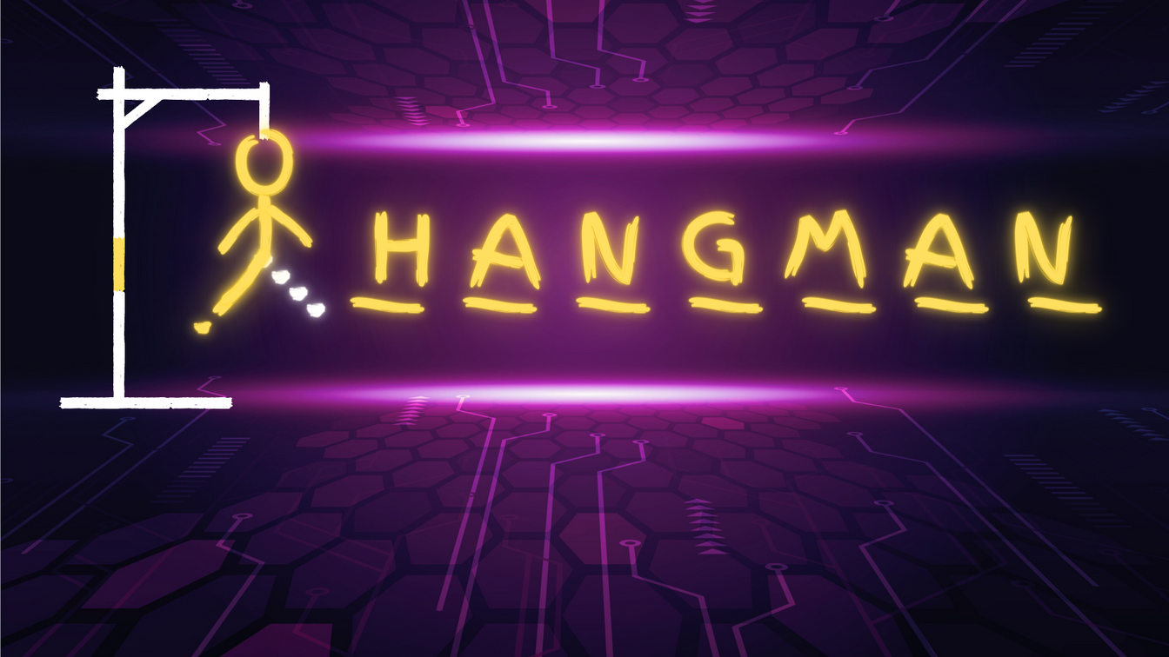
INTRODUCTION
Hangman is a Word Guessing Game for two or more players. One player thinks of a word, phrase or sentence and the other(s) tries to guess it by suggesting letters within a certain number of guesses. Originally a Paper-and-Pencil game, there are now Electronic Versions.
We have created one such electronic version of Hangman using python.

Slide 4
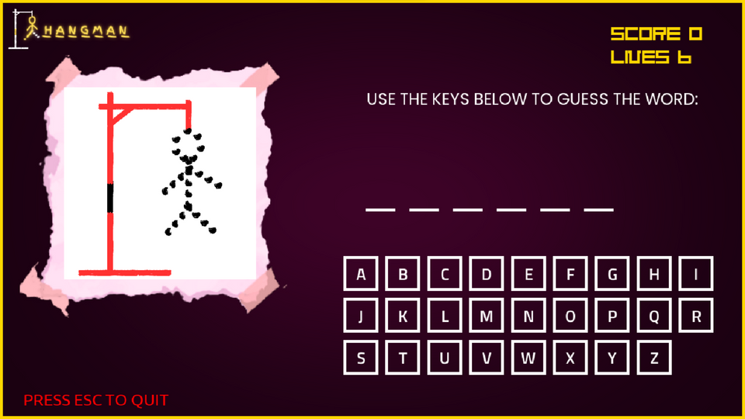
OVERVIEW:
•The game starts with, the word to guess is represented by a row of dashes, representing each letter of the word.
•If the suggested letter does not occur in the word, the player draws one element of a hanged man stick figure
•If a guess is correct , the points are assigned based on the guesses.
•The hangman has six body parts that are drawn. (for 6 letter guesses) in the order .
• The round ends either when the player has guessed all the word correctly, or after six incorrect guesses when the man has been hanged.

Slide 5


LANGUAGE USED:
SYSTEM REQUIREMENTS:
Python: It is a high level, interpreted, general-purpose programming language. Its design philosophy emphasizes code readability with the use of significant indentation. Python is dynamically- typed and garbage-collected language.
A computer with at least a 1GHz processor
At least 512MB of RAM
A graphics card capable of rendering 2D graphics
Python 3.x installed
However, it is recommended to have a more powerful computer to ensure smooth performance and a better gaming experience.

Slide 6




Softwares used:
Visual Studio Code
Canva
A Graphic designing platform that is used to create graphics and presentations. In game background graphics and characters are designed using the app.
It is streamlined code editor with support of development operations like debugging, task running etc.
Python libraries used :
pygame: a set of Python modules designed for writing video games.
random: a module that implements pseudo-random number generators for various uses.
sys: a module that provides access to some variables used or maintained by the interpreter and to functions that interact strongly with the interpreter.

Slide 7
FUNCTIONS USED
IN CODE:
pygame.init()
pygame.display.set_mode()
pygame.time.Clock()
pygame.font.Font()
This function initializes all the imported pygame modules.
This function sets the display mode and returns a surface object representing the game window.
This function creates a Clock object that can be used to control the frame rate of the game.
This function creates a Font object that can be used to render text in a particular font and size.
pygame.mixer.Sound()
pygame.image.load()
random.choice()
pygame.Surface()
This function loads a sound file and returns a Sound object that can be used to play the sound.
This function loads an image file and returns a Surface object that can be used to display the image.
This function chooses a random element from a sequence.
This function creates a new Surface object with the specified dimensions.
pygame.Rect()
pygame.sprite.Sprite()
Font.render()
Rect.collidepoint()
This function creates a new Rect object with the specified coordinates and dimensions.
This function creates a new Sprite object.
This function renders the specified text using the font and size of the Font object and returns a Surface object representing the rendered text.
This function checks if the given point is inside the Rect object.

Slide 8
FUNCTIONS USED
IN CODE:
pygame.draw.rect()
win.blit()
Button.collision()
Button.update()
This function draws a rectangle on the surface object.
This function copies the contents of one surface to another surface.
This function checks if the mouse cursor is over the button and returns True if the button is clicked.
This function updates the button by drawing it on the game window.
Button.reset()
FadeScreen.update()
FadeScreen.draw()
Button()
This function resets the button to its default state.
This function updates the alpha value of the surface to create a fading effect.
This function draws the surface on the game window.
This class is defined in a separate button module. It contains methods to draw and update the buttons and check for mouse clicks.
get_font()
play()
options()
main_menu()
This function takes in a font size and returns a pygame font object with the desired size.
This function is called when the user clicks on the "START" button in the main menu. It imports and calls the testing_pop module, which contains the main logic of the game.
This function is called when the user clicks on the "CREDITS" button in the main menu. It displays the group project name and a "BACK" button, which returns the user to the main menu when clicked.
This function is the main entry point of the game and is called when the script is run. It displays the game title, background image, and three buttons ("START", "CREDITS", and "QUIT"). It waits for the user to click on one of the buttons and calls the appropriate function depending on the user's input

Slide 9
CODE
def main_menu():
while True:
SCREEN.blit(BG, (0, 0))
MENU_MOUSE_POS = pygame.mouse.get_pos()
pygame.draw.rect(SCREEN, (255,215,0), (0,0,screen_width,screen_height), 5)
MENU_TEXT = get_font(100).render("HANGMAN GAME", True, "#ffd700")
MENU_RECT = MENU_TEXT.get_rect(center=(640, 100))
PLAY_BUTTON = Button(image=pygame.image.load("Assets/Play Rect.png"), pos=(640, 250),
text_input="START", font=get_font(55), base_color="#d7fcd4", hovering_color="White")
OPTIONS_BUTTON = Button(image=pygame.image.load("Assets/Options Rect.png"), pos=(640, 400),
text_input="CREDITS", font=get_font(55), base_color="#d7fcd4", hovering_color="White")
QUIT_BUTTON = Button(image=pygame.image.load("Assets/Quit Rect.png"), pos=(640, 550),
text_input="QUIT", font=get_font(55), base_color="#d7fcd4", hovering_color="White")
SCREEN.blit(MENU_TEXT, MENU_RECT)
for button in [PLAY_BUTTON, OPTIONS_BUTTON, QUIT_BUTTON]:
button.changeColor(MENU_MOUSE_POS)
button.update(SCREEN)
for event in pygame.event.get():
if event.type == pygame.QUIT:
pygame.quit()
sys.exit()
if event.type == pygame.MOUSEBUTTONDOWN:
if PLAY_BUTTON.checkForInput(MENU_MOUSE_POS):
play()
if OPTIONS_BUTTON.checkForInput(MENU_MOUSE_POS):
options()
if QUIT_BUTTON.checkForInput(MENU_MOUSE_POS):
pygame.quit()
sys.exit()
pygame.display.update()
MAIN MENU

Slide 10
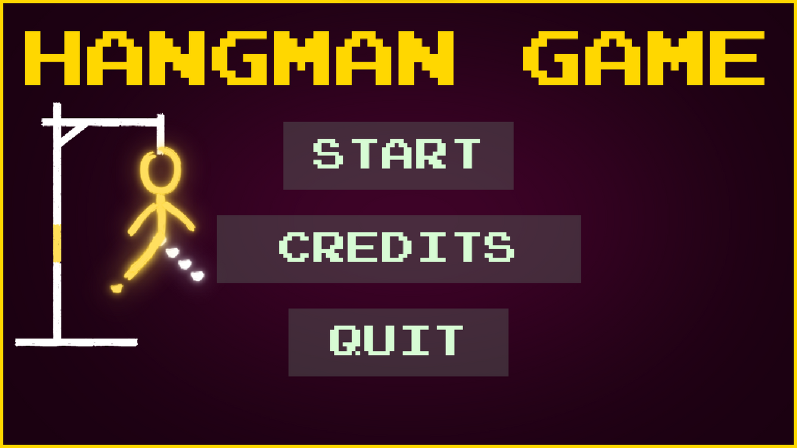
OUTPUT
MAIN MENU

Slide 11
CODE
class Button():
def __init__(self, image, pos, text_input, font, base_color, hovering_color):
self.image = image
self.x_pos = pos[0]
self.y_pos = pos[1]
self.font = font
self.base_color, self.hovering_color = base_color, hovering_color
self.text_input = text_input
self.text = self.font.render(self.text_input, True, self.base_color)
if self.image is None:
self.image = self.text
self.rect = self.image.get_rect(center=(self.x_pos, self.y_pos))
self.text_rect = self.text.get_rect(center=(self.x_pos, self.y_pos))
MENU OPTIONS
for event in pygame.event.get():
if event.type == pygame.QUIT:
pygame.quit()
sys.exit()
if event.type == pygame.MOUSEBUTTONDOWN:
if PLAY_BUTTON.checkForInput(MENU_MOUSE_POS):
play()
if OPTIONS_BUTTON.checkForInput(MENU_MOUSE_POS):
options()
if QUIT_BUTTON.checkForInput(MENU_MOUSE_POS):
pygame.quit()
sys.exit()

Slide 12
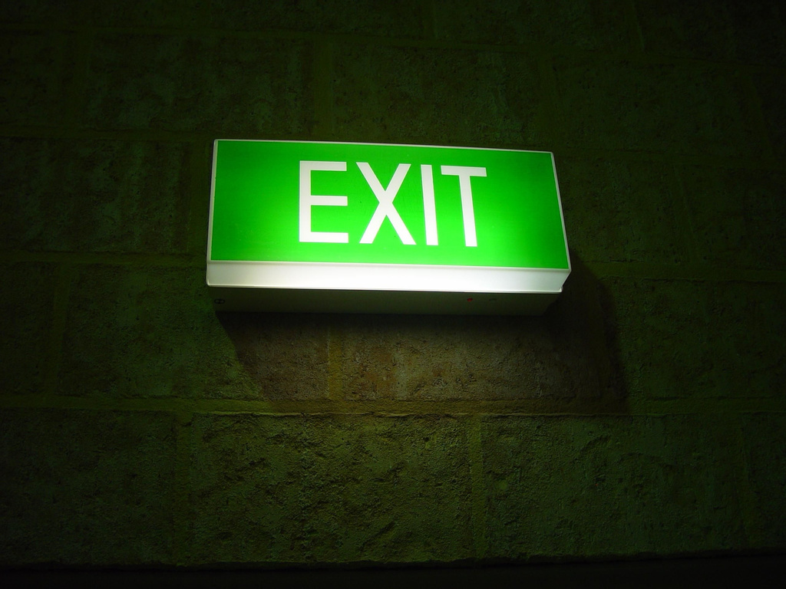
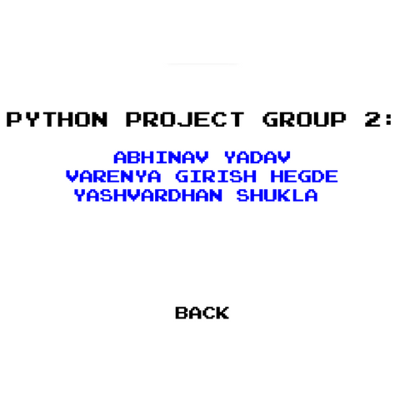
OUTPUT
MENU OPTIONS

Slide 13
CODE
class FadeScreen:
def __init__(self, w, h, colour):
self.surface = pygame.Surface((w, h))
self.surface.fill(colour)
self.alpha = 255
self.surface.set_alpha(self.alpha)
def update(self):
self.alpha -= 2
self.surface.set_alpha(self.alpha)
def draw(self, x, y):
win.blit(self.surface, (x,y))
FADING SCREEN
fadeScreen = FadeScreen(screen_width, screen_height, BLACK)
if homepage:
if fadeScreen.alpha >= 0:
fadeScreen.update()
fadeScreen.draw(0,0)
opening_animation.set_alpha(fadeScreen.alpha)
win.blit(opening_animation, (screen_width - opening_animation.get_width() , screen_height - opening_animation.get_height()))

Slide 14
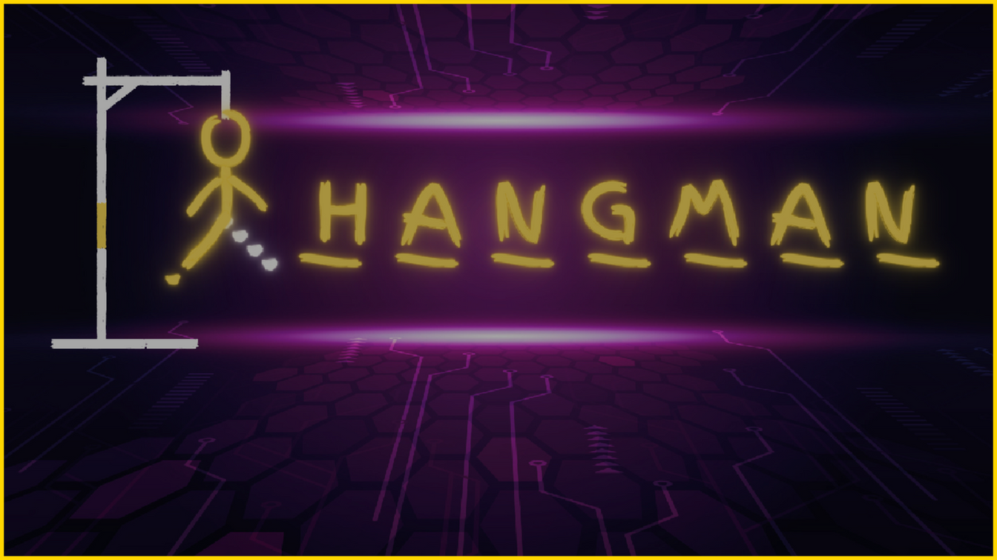
OUTPUT
FADING SCREEN

Slide 15
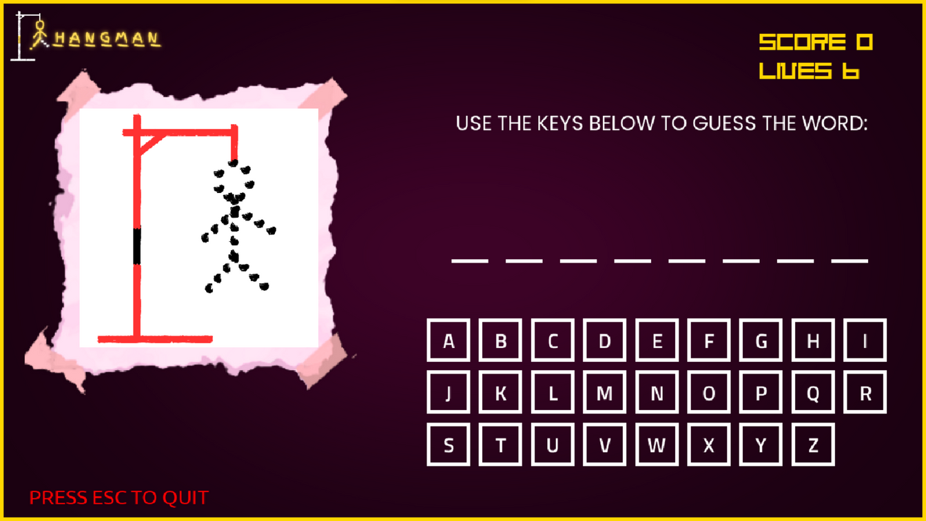
OUTPUT
BASIC GAME SCREEN

Slide 16
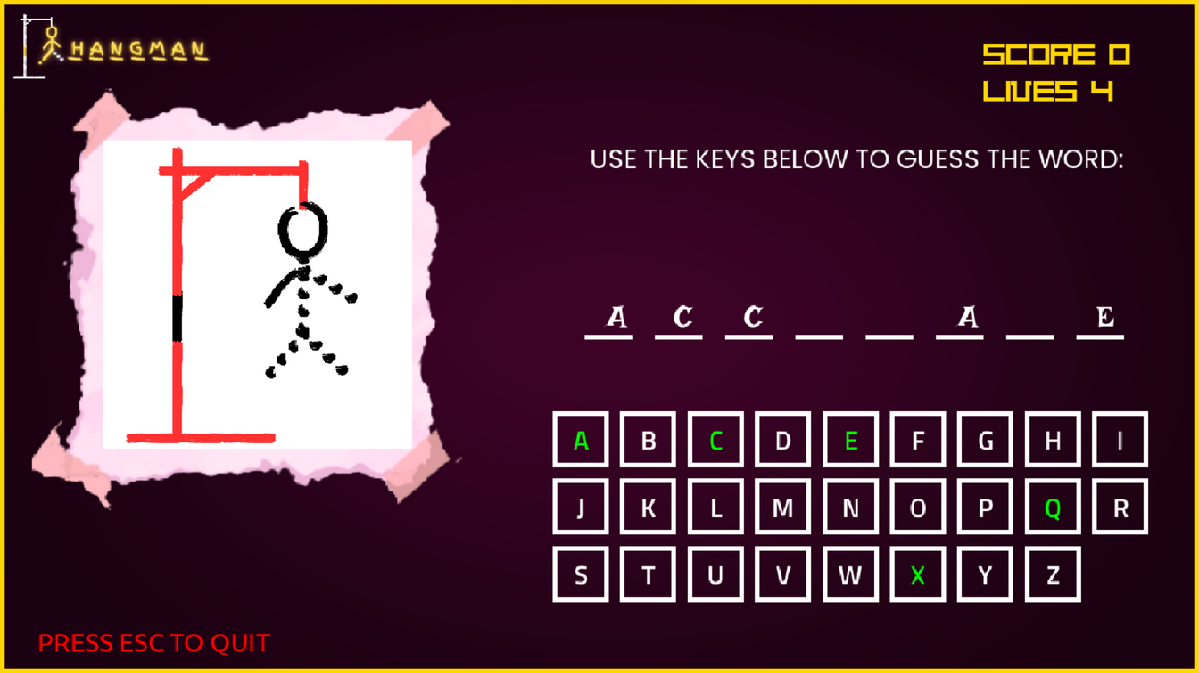
OUTPUT
WHILE PLAYING

Slide 17
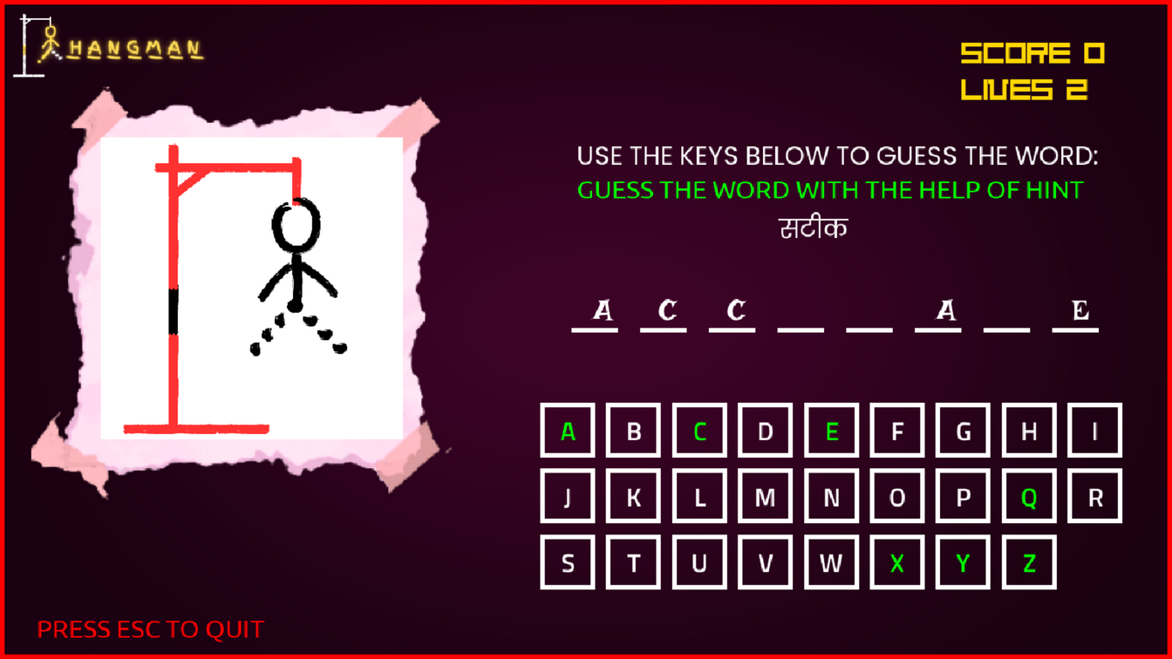
OUTPUT
ALERT AND HINT
@
LIVES = 2

Slide 18
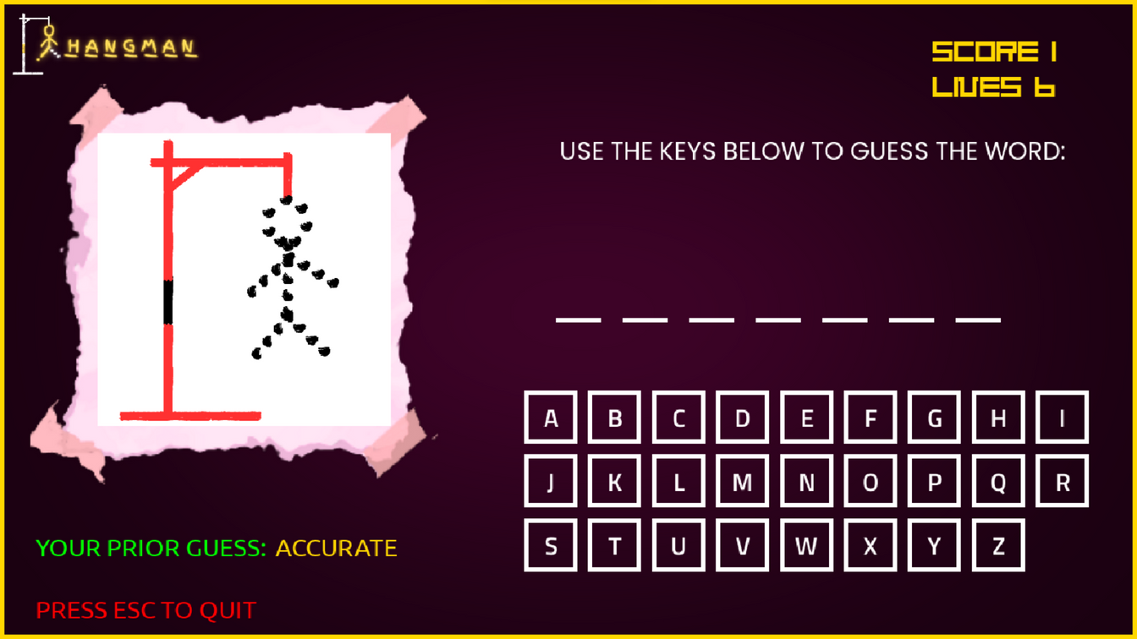
OUTPUT
AFTER A RIGHT ANSWER

Slide 19
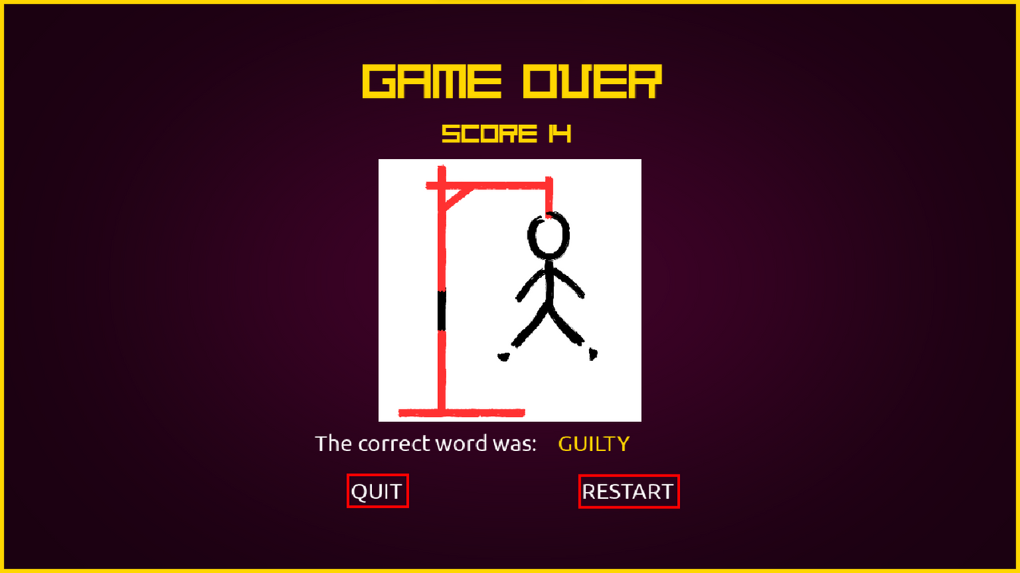
OUTPUT
UNABLE TO GUESS

Slide 20
THANK YOU

